Slide 1
HR Insights Unlocked ! Power BI Dashboard | Data Analytics
- Maria monisha J

Slide 2
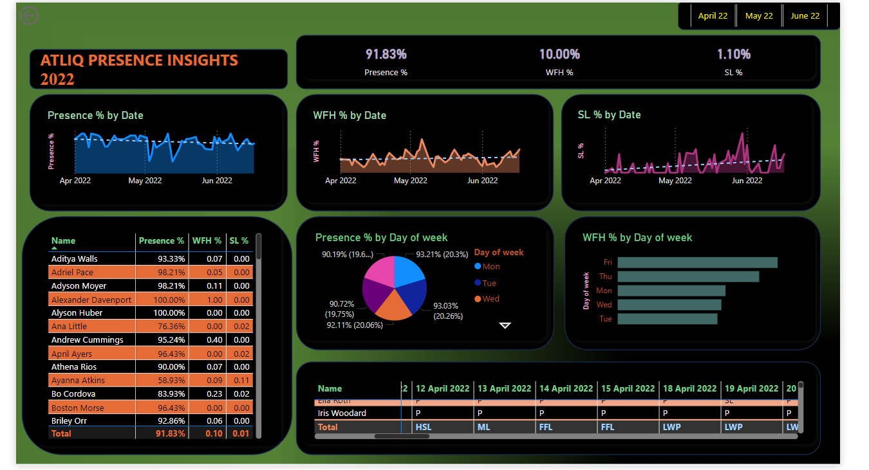

Slide 3
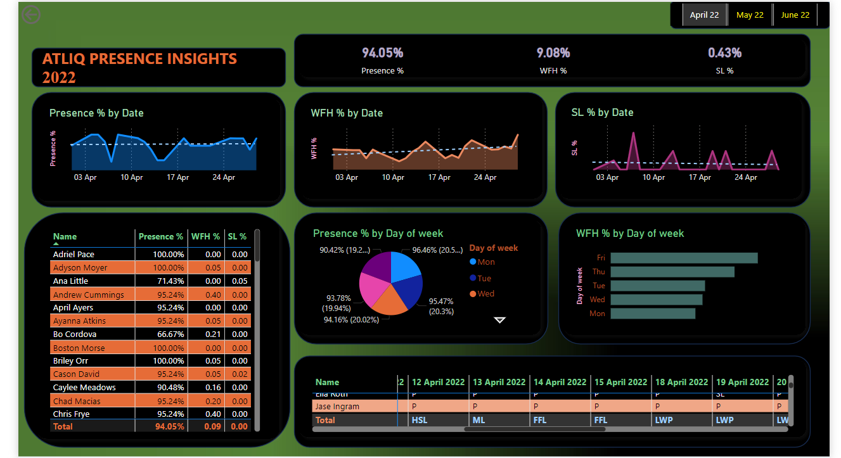

Slide 4
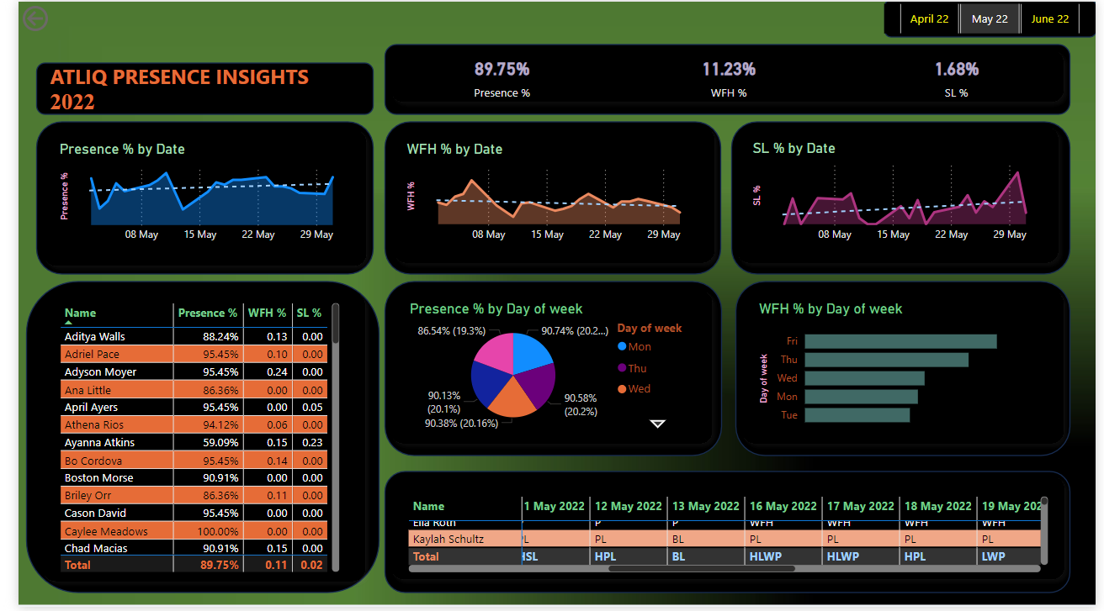

Slide 5
